Slide 1


Pitch Deck, 2019-2020
Powering smarter, safer cities

Slide 2

COM-IoT Technologies helps governments and enterprise companies enhance the security, safety and wellbeing of our communities through the use of artificial intelligence powered solutions

Slide 3
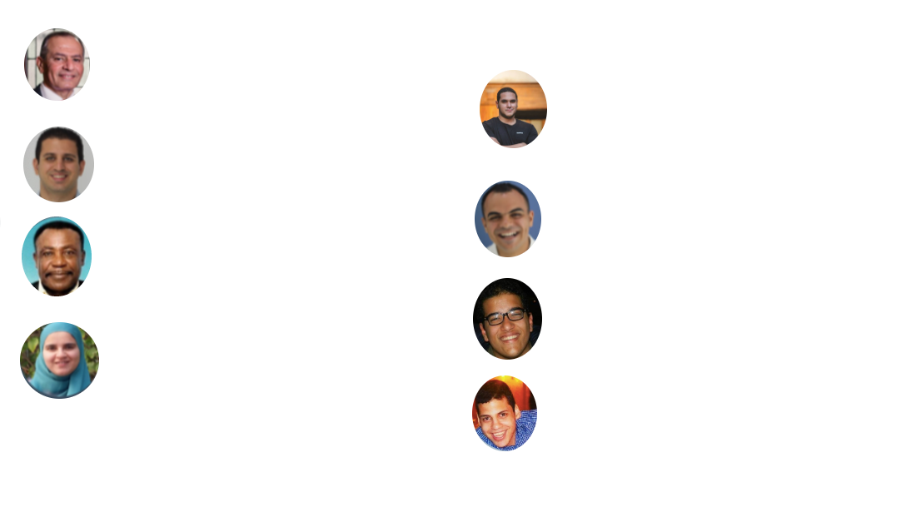
Mohamed Sadek, Founder/CEO
Agile leader with 20+ years in telecommunications. MSCS, University of Illinois, m-MBA, University of Pennsylvania. Devoted to people-centric innovation
Loay Amin, Senior machine learning engineer with 2+ year experience in data science, computer vision and hardware deployment.
Eslam Mohamed, BD Manager Experiences sales & BD leader with 8+ years in smart city technology, power generation and energy management. Led new business across GCC & Egypt
Mohamed Assaf, Software engineer, experienced Full stack web developer with very good command of Javascript and .Net framework.
Omar Barakat, Lead developer, machine learning, LiDAR expert. Computer vision, Visual analytics, Strong analytics development skills.
Abdarhman Taha, Lead Developer
R&D software engineer leading product development and research design. Visual Analytics, Computer vision, deep learning. He is a LiDAR and embedded software expert
Micheal Parker, COO/Board Member
30+ years in executive leadership, program management & telecoms, an authority on the introduction of high tech to emerging markets
Youssra ElQattan, Deep Learning Engineer
Computer vision & deep learning pro, built a patented distracted driver detection application. EU Tempus Program participant, 2012.

Slide 4

Team
Youssra ElQattan, Developer. Youssra is responsible for developing human behavioral analytics. Distracted Driver detection, Seat belt detection, and other similar attributes. She and Ahmed have their names on the patent filed with the U.S. patent office for our distracted driver detection solution.
Omar Barakat, Developer. Omar is in charge of our LiDAR based solutions including 3D mapping. He developed both stationery and smart police patrol speed detection. He is finalizing our People recognition and tracking PR&T. He also does machine learning technologies and has developed our Siraat’s people and object counting solution.
Mahmoud Zidan, Developer. Mahmoud is also working closely with Omar on all of our solutions. He developed the detection of vehicle make, model and color and has enhanced the detection and tracking of vehicles. He has developed sensor fusion and LiDAR Camera calibration & synchronization, Varci and many others.

Slide 5

Team – cont.
Abdarhman Taha, R&D software engineer leading product development and research design. Computer vision, deep learning. He is a LiDAR and embedded software expert
Loay Amin, LiDAR expert, developer, Computer vision and Machine Learning. Contribute significantly to our PR&T and Varci deployment and Var
Mohamed Assaf, Software developer, leads our dashboard work across HORUS, P3 and I-Trac
Eslam Ahmed, BD manager. Eslam leads our market strategy, lead generation, opportunity building and customer relationship.
Kenneth Fernandez, LiDAR expert, ML/CV Expert Senior Engineer

Slide 6

Team – Cont.
Mohamed Sadek, Founder. Mohamed leads the team and supports the startup in funding and customer relationships, as well as door-opening across enterprise partnerships.

Slide 7

Employee Count & Commitment
Total count: 7 (5 full time, 2 part-time)
The team’s commitment is solid. They are superbly talented, each in their areas, demonstrating their skill and practicing new techniques each day. Brimming with passion for their work and the goals of our organization, our team is committed to ensuring the success of the startup by enthusiastically using their personal time to help the company succeed over the last two years.
Retention is necessary through a variety of means including pay, company shares and other ways.

Slide 8

Hiring plan
COM-IoT requires additional developers with machine learning and deep learning skills and experience.
We source technical roles regionally in Egypt where we can tap into affiliated companies who can provide needed AI software engineers and developers who excel in machine learning and video analytics skills.
We require six additional developers (3 in Cairo; 3 in Dubai)
We require 3 business development persons (2 GCC based; 1 in Egypt)

Slide 9
Hiring Plan: Technical
Dubai |  | Cairo
Developer 1 | Developer 2 | Developer 3 | Developer 4 | Developer 5 | Developer 6
P3 & HORUS: General, hardware integration and software | ID&T: Development & UI Smart Cities: Backend & User Interface | P3 & HORUS: Distracted Driving & Speed | P3 & HORUS: Tailgating | Smart Cities: Backend Development | ID&T: Development
Hiring Plan: Business Development
Our plan is to expand the sales team as below
1 Business development Manager in KSA
1 Business Development Manager in Egypt
Expand our sales team in the UAE to 3 Engineers

Slide 10

Intellectual Property: HORUS, P3 & I-Trac
Distracted Driver Detection has been filed with the U.S. Patent office
Intruder Identification & Tracking has been filed with the U.S. patent office
Speed Enforcement Smart Patrol P3
Filing is done through Foley & Hoag Patent Law firm, Boston, MA

Slide 11

Customer pains
Traffic safety: Speeding, distracted driving, unregulated driving offenses, and delayed weather monitoring systems resulting in frequent road collisions and fatalities
Public security: Public spaces vulnerable to security breach and intrusion by wanted/unauthorized persons and dangerous objects; delayed entry by authorized personnel
City and municipality: Conventional trash collection systems waste fuel and time, slowing traffic by relying on unoptimized waste collection systems. Congestion in high-traffic zones such as downtown, near malls and tourist attractions due to manual parking management and limited parking visibility.

Slide 12

Customer gains
Strengthening government’s ability to reduce traffic collisions, related fatalities and property damage and anticipate challenges to road safety
Identifying and tracking wanted and unauthorized persons and providing rapid access to authorized personnel using facial recognition software and intrusion detection and tracking

Slide 13
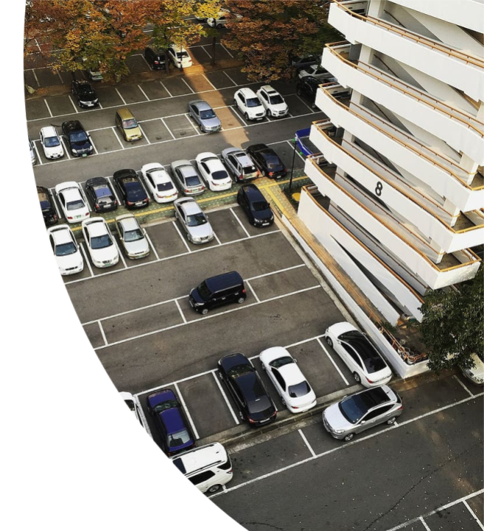
Customer gains - cont.
Saving costs on fuel consumption and resources, reducing traffic congestion and reducing time wasted and environmental impact of searching for parking caused by:
Costly and inefficient waste collection practices and systems
legacy inefficient parking management systems
Improving the livability, happiness and security of communities, improving quality of life

Slide 14
Customizable solutions
With flexible agreements and customizable services, our tailored solutions help address the challenges of urban communities by augmenting cities’ traffic, security and municipal administration.

Slide 15

Financials
Financial statement separate.
Burn rate: Range AED 110k – 140k
Runway: 8 months
No liabilities

Slide 16

Single owner structure
Ownership Structure

Slide 17

COM-IoT Global Vision
Our intelligent solutions are applicable everywhere and hence, our theoretical total addressable market is global in nature.
Due to the limitations on our current resources, we focus on building our business in the UAE, Saudi Arabia, GCC countries, and Egypt
We take advantage of opportunities outside of the above regions as we see them, either through direct relationships (Indra), or with our partners who are global companies (IBM, Thales and others)

Slide 18

Addressable Market
Police Enforcement entities in UAE (Dubai. Abu Dhabi, Sharjah, etc.)
Municipalities within United Arab Emirates
Smart city application for private sectors & developer (Meraas, Nakheel, MAF, DP World, etc.)
KSA’s vision 2030 present a lot of opportunities in smart city, security & traffic safety applications
Egypt’s new mega cities (New Capital & Al AlAmin) offer huge potential for our solutions in smart city applications
Law enforcement entities across the GCC & Singapore, Malaysia, etc.
International demand is starting to be demonstrated
Government for security application across the region
Large IT & technology companies such as (IBM, Thales and Indra, Aramco, ADNOC)

Slide 19
Current Engagements & Funnel.
Client | Project
Dubai Police | HORUS. Contract under preparation AED 500k
Crown Prince’s Court/Etisalat | II&T - Mushrif Palace – Conrtact under completion AED 1.2M
Crown Prince’s Court/Etisalat | II&T What Al Karama – AED 900k
Abu Dhabi Police/Tatweer | P3 – Smart Patrol – Contract under preparation AED 1.5M
Etisalat/Dubai Police | II&T Oyoon – City Walk – Fully completed AED 240k
Etisalat/Dubai Police | II&T Oyoon – Dubai Airport – PO in processed AED 350k
Lamprell | II&T Awaiting customer response to proposal
Bombardier/Hint | II&T Awaiting customer response to proposal

Slide 20
Current Engagement & Funnel
Client | Project
Abu Dhabi police | RFQ Intelligence police patrol enchantement 200+ unit
Dubai Police: Operations Department | integration with Drone management system our analytical solutions for ANPR & facial recognition
Dubai Police: Artificial Intelligence Department | Waiting for 1000+ smart patrol vehicles tender
Dubai Police: Artificial Intelligence Department | Facial recognition POC & they will draft a tender with our specification when succeed
Dubai Police: Traffic Technologies Department | Truck driver behavior POC & to be implemented when succeed
Dubai Municipality | POC and technology overview made, waiting for People counting system tender
Abu Dhabi Municipality | Initial POC made, waiting for smart parks tender
Sharjah Municipality | Progressing discussion underway for trucks waste management monitoring system implementation
RTA | Smart Sign in for RTA Building
DP World | Progressing discussions underway for Smart building solutions
DP World | Hotel room door management system for Queen Elizabeth Hotel
IBM | IBM uses our Facial recognition system currently in their Abu Dhabi client center

Slide 21
Current Engagement – cont.
Client | Project
IBM | Discussions are underway for design of special hardware from IBM for our P3 solution This will lead to IBM’s direct engagement on major projects that we are now discussing such as FirstNet in the USA
Egypt | Early discussion underway regarding the New Capital smart city solutions
Indra | Two contracts signed regarding traffic safety and smart city solutions. On hold due to governments’ GDPR preparation
Indra | Multiple private sector potential opportunities are now in discussion
Thales | Early discussion underway at their request
Kazakhstan, UK1, Uk2, Kuwait, | I-Trac
ADNOC | Offshore locations I-Trac

Slide 22

Length of Sales Cycle
Length of the sales cycle varies from one solution to another
Traffic safety solutions within police enforcement organization may see sales cycles lasting between 3 to 9 months
Smart city applications for municipalities can vary between 3 to 6 months
Private sector sales cycles can vary from 3 to 6 months
Sales cycles will always require a PoC stage requiring resources, both human and financial.

Slide 23
Proof of Concepts – Funding required to grow team & equipment for list of PoC’s).
Status | Project | Client
Previous POC | Distracted driver detection | Dubai Police traffic technologies department
 | People counting system | Dubai Municipality
 | People counting & Tracking | VVIP
 | People counting system | Abu Dhabi Municipality, EXPO, Lamprel, GHQ DP
Current POC | HORUS DDD + Speed | Ajman Police HORUS
Current | People counting & tracking | Wahat Alkarama
Upcoming POC | Smart Sign-in | RTA
 | Smart Police Patrol | Dubai Police AI Department
 | Truck driver behavior | Dubai Police traffic technologies department
 | Smart meeting room and II&T | DP World
 | Power spike monitoring | Dubai Properties
 | Facial Recognition & ANPR for Drone | Dubai Police Operation Department
 | ANPR | Dubai Police Operation Department
 | Distracted Driver behavior detection for Officers inside Police Patrol | Dubai Police Operation Department
 | Distracted Driver detection | Dubai Police AI Department
 | Intelligence Police vehicle System | Abu Dhabi Police
 | Smart Police Patrol | Dubai Police traffic technologies department
 | Smart Sign-in | DP World
 | Truck Waste Management system | Sharjah Municipality

Slide 24

Offering
I-Trac
Plug and Play Patrol (P3)
HORUS
Click here for detailed product descriptions.

Slide 25

Traction
Etisalat Digital Cohort 5 MOU
Etisalat Digital 2 PoC’s & 3 in-progress contracts
ADNOC – I-Trac-
IBM – Global partnership + joint project
Dubai Police – HORUS deployed on Emarat Rd
Dubai Police - Plug and Play Patrol (P3) MOU
Dubai Municipality – Partnership
Abu Dhabi Municipality – Partnership

Slide 26

Traction - cont.
Sharja Municipality
Dubai Police Academy – Partnership + Joint project
Abu Dhabi Police – Smart Patrol P3 Tender response with Tatweer as our partner
Thales – Security solution dialogue
UK1, UK2, (Mappix solutions), Kazakhstan Esari (Sintek), Kuwait Parlimant (KDCC)
Ajman Police – HORUS DDD

Slide 27

Market
Global:
Traffic regulators – Police departments
Security (Airports, Ports, Banks, Hospitals, Malls, etc.)
Cities/municipalities: City parks, waste management, parking management, regulation enforcement, etc.)

Slide 28

Competition “Every competitor is a potential partner”
Given that we work in 3 main fields: Security, traffic safety and smart cities, our competitors come from different areas: They are big companies such as IBM, Vitronic, Sensys Gatso, Siemens, Cisco and Huawei as well as technology startups such as ourselves.
Our smart video analytics competitors include companies like Fujitsu and Thales
We take our competitors very seriously and are making sure that we remain ahead of the pack on the technology that we develop, our level of service and maintain competitive pricing models.
Notes:
Needs work

Slide 29

Business Model
We follow a flexible business model based on the specific market standard. We are aware different markets and different customers have variable preferences.​
Below are the different approaches we follow:
B2G Direct to government entities (i.e. Dubai Police, Dubai Ports)
B2B Indirect through IT/Telecom company (i.e. IBM, Indra)
B2B2G
Revenue: 1- Monthly charges per service (license based)
Revenue: 2- Lump sum (License included for the full term/number of years)

Slide 30

Investing
We are looking to raise USD 2 million to facilitate the required expansion in our development team, sales & business development team, administration, finance and accounting
Equipment acquisition/lab expansion
Office facilities for development team in Cairo
Marketing and outreach programs

Slide 31

Investor’s ROI
Current valuation estimate $30M:
AI solutions, U.S. patents (3), Revenue, competitive wins, high demand market for security an for traffic safety, pipeline, market traction.
Company sales expected to triple within 24 months
Within 1.5 – 2 years, raise company valuation to $100M - $150M and start round 2 for $10 - $15 M
Valuation increase through:
- Continued innovations
- SALES in the UAE, GCC, Middle East, and internationally to demonstrate global demand
Company organic growth starting in the region, UAE, Saudi, Egypt

Slide 32

Path to Liquidity
Investment needed is $2M
Required to add the additional developers and business development managers and the required additional equipment to increase our customer PoC rate and satisfy the needed tests and trials.
Path to liquidity: Acquisition by a larger company, or IPO

Slide 33
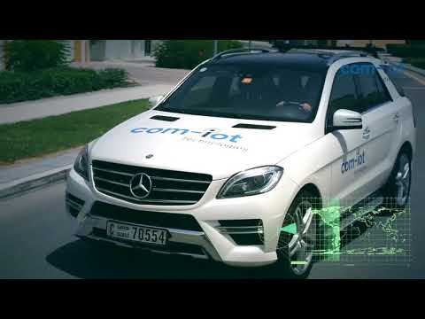
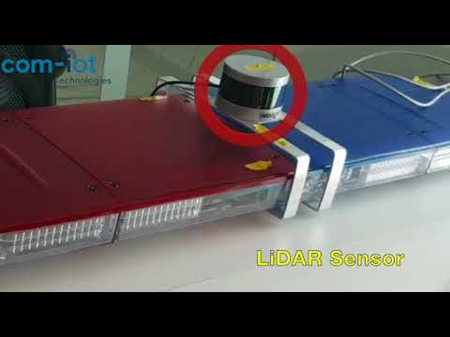
Video Demonstration
COM-IoT P3 Demonstration
Intelligent Light Bar P3

Slide 34
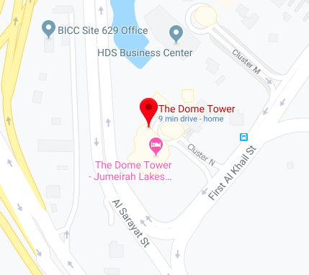
Contact
Location
Mohamed Sadek, Co-founder, CEO
Mohamed.Sadek@com-iot.com
+971 55 103 2444
Eslam Ahmed, BD manager eslm.ahmed@com-iotr.com
+971 52 564 3275

